Slide 1
3D MIMO-SAR IMAGING SYSTEM
SYSTEM OVERVIEW
USER MANUAL
MUHAMMET EMIN YANIK
ADVISOR: PROF. MURAT TORLAK
The University of Texas at Dallas
May, 2019
1

Slide 2
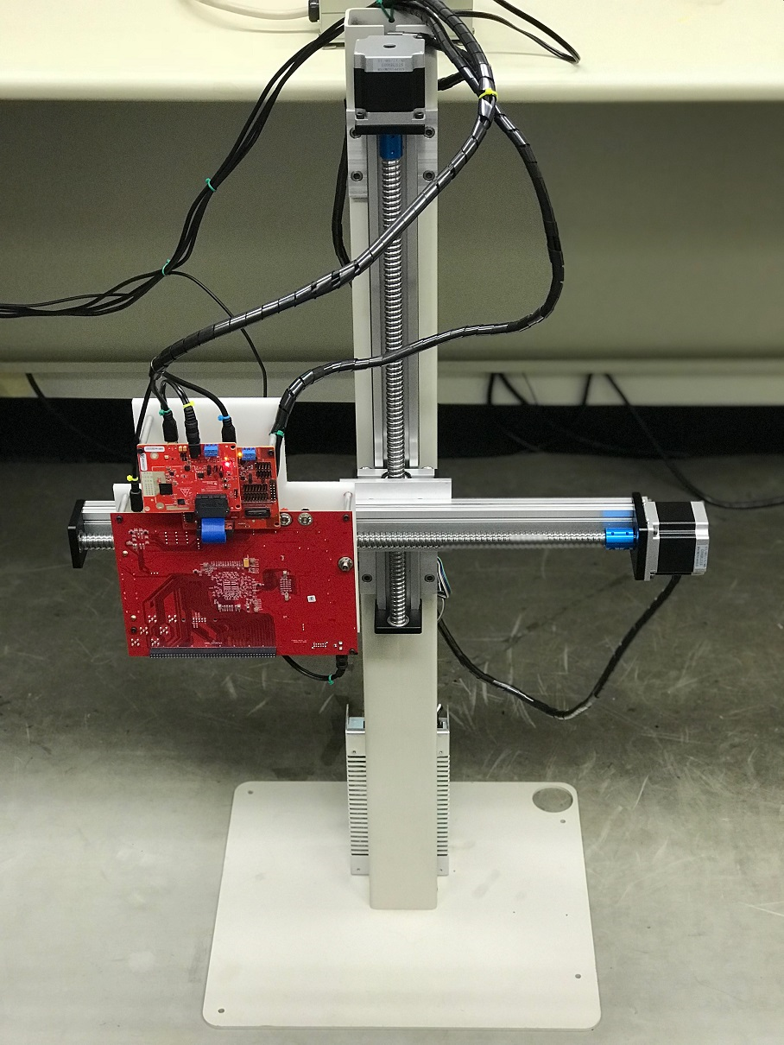
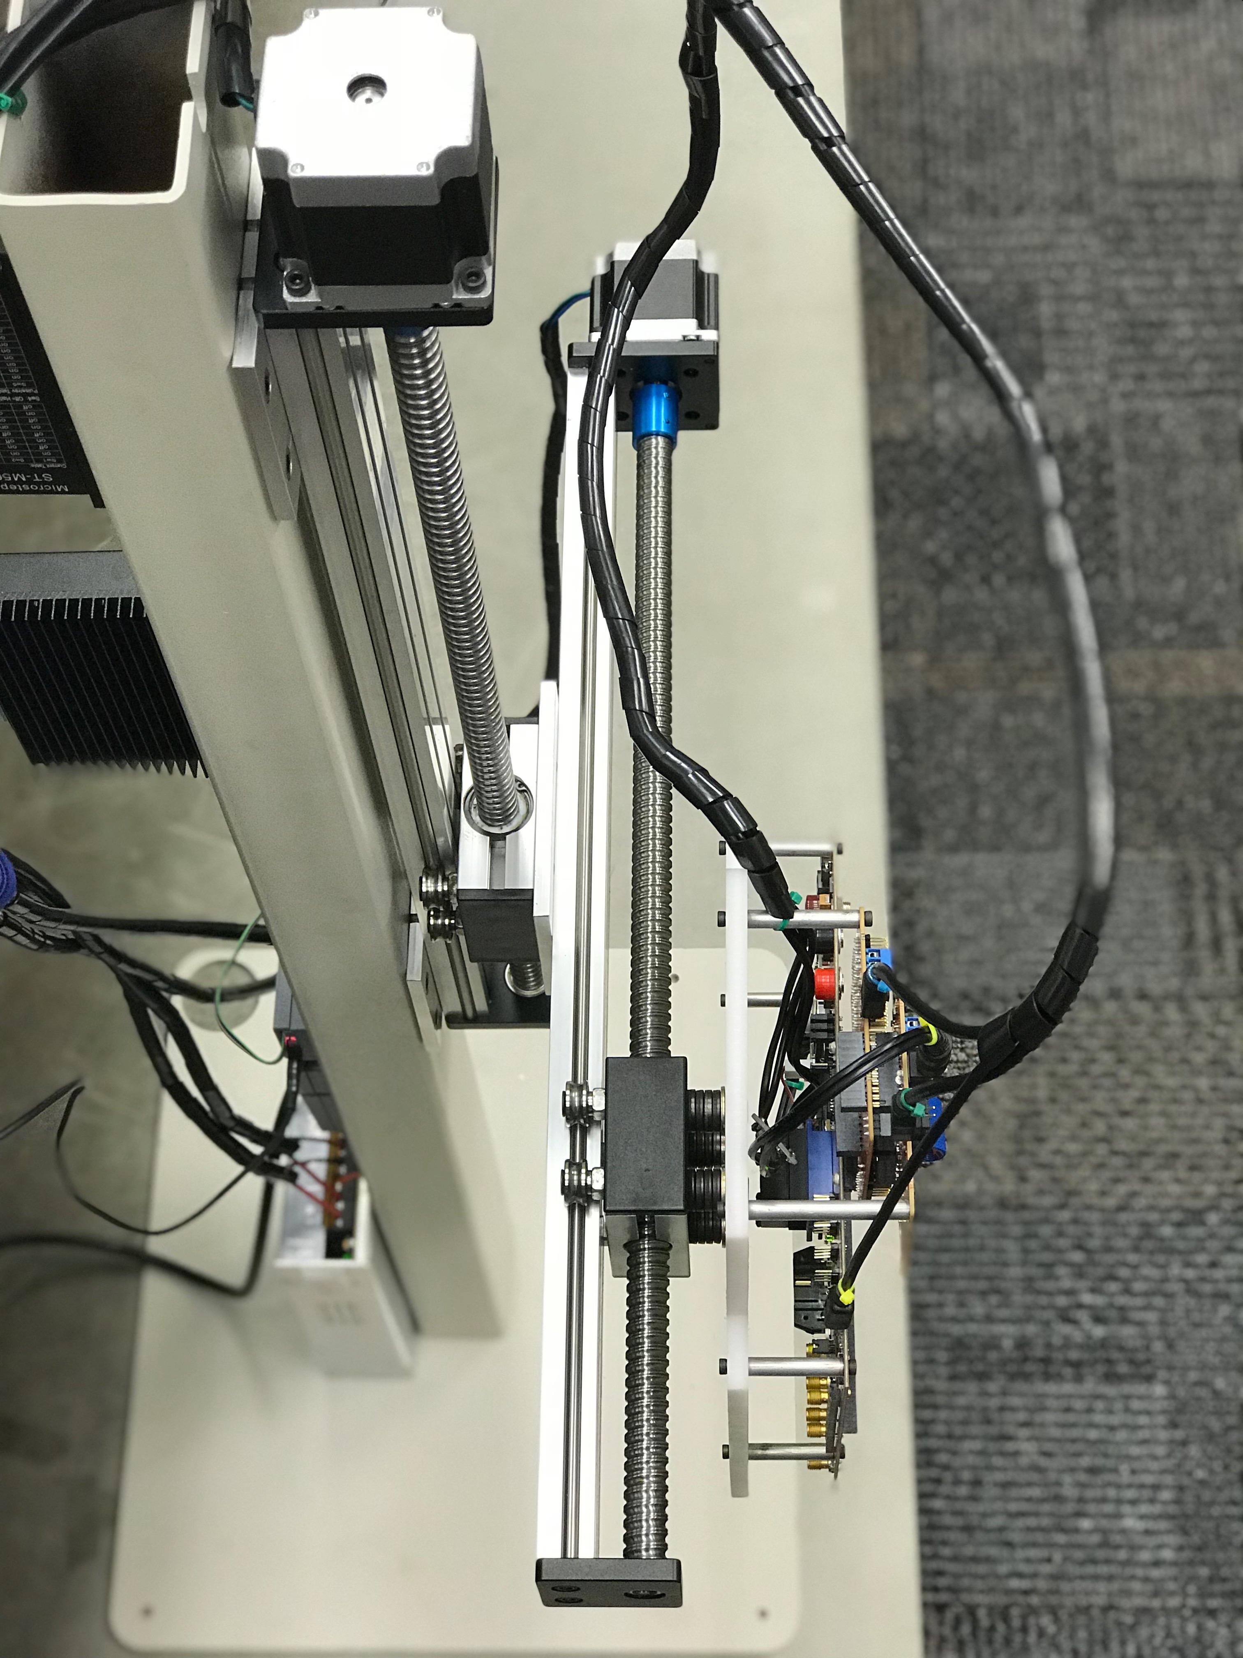
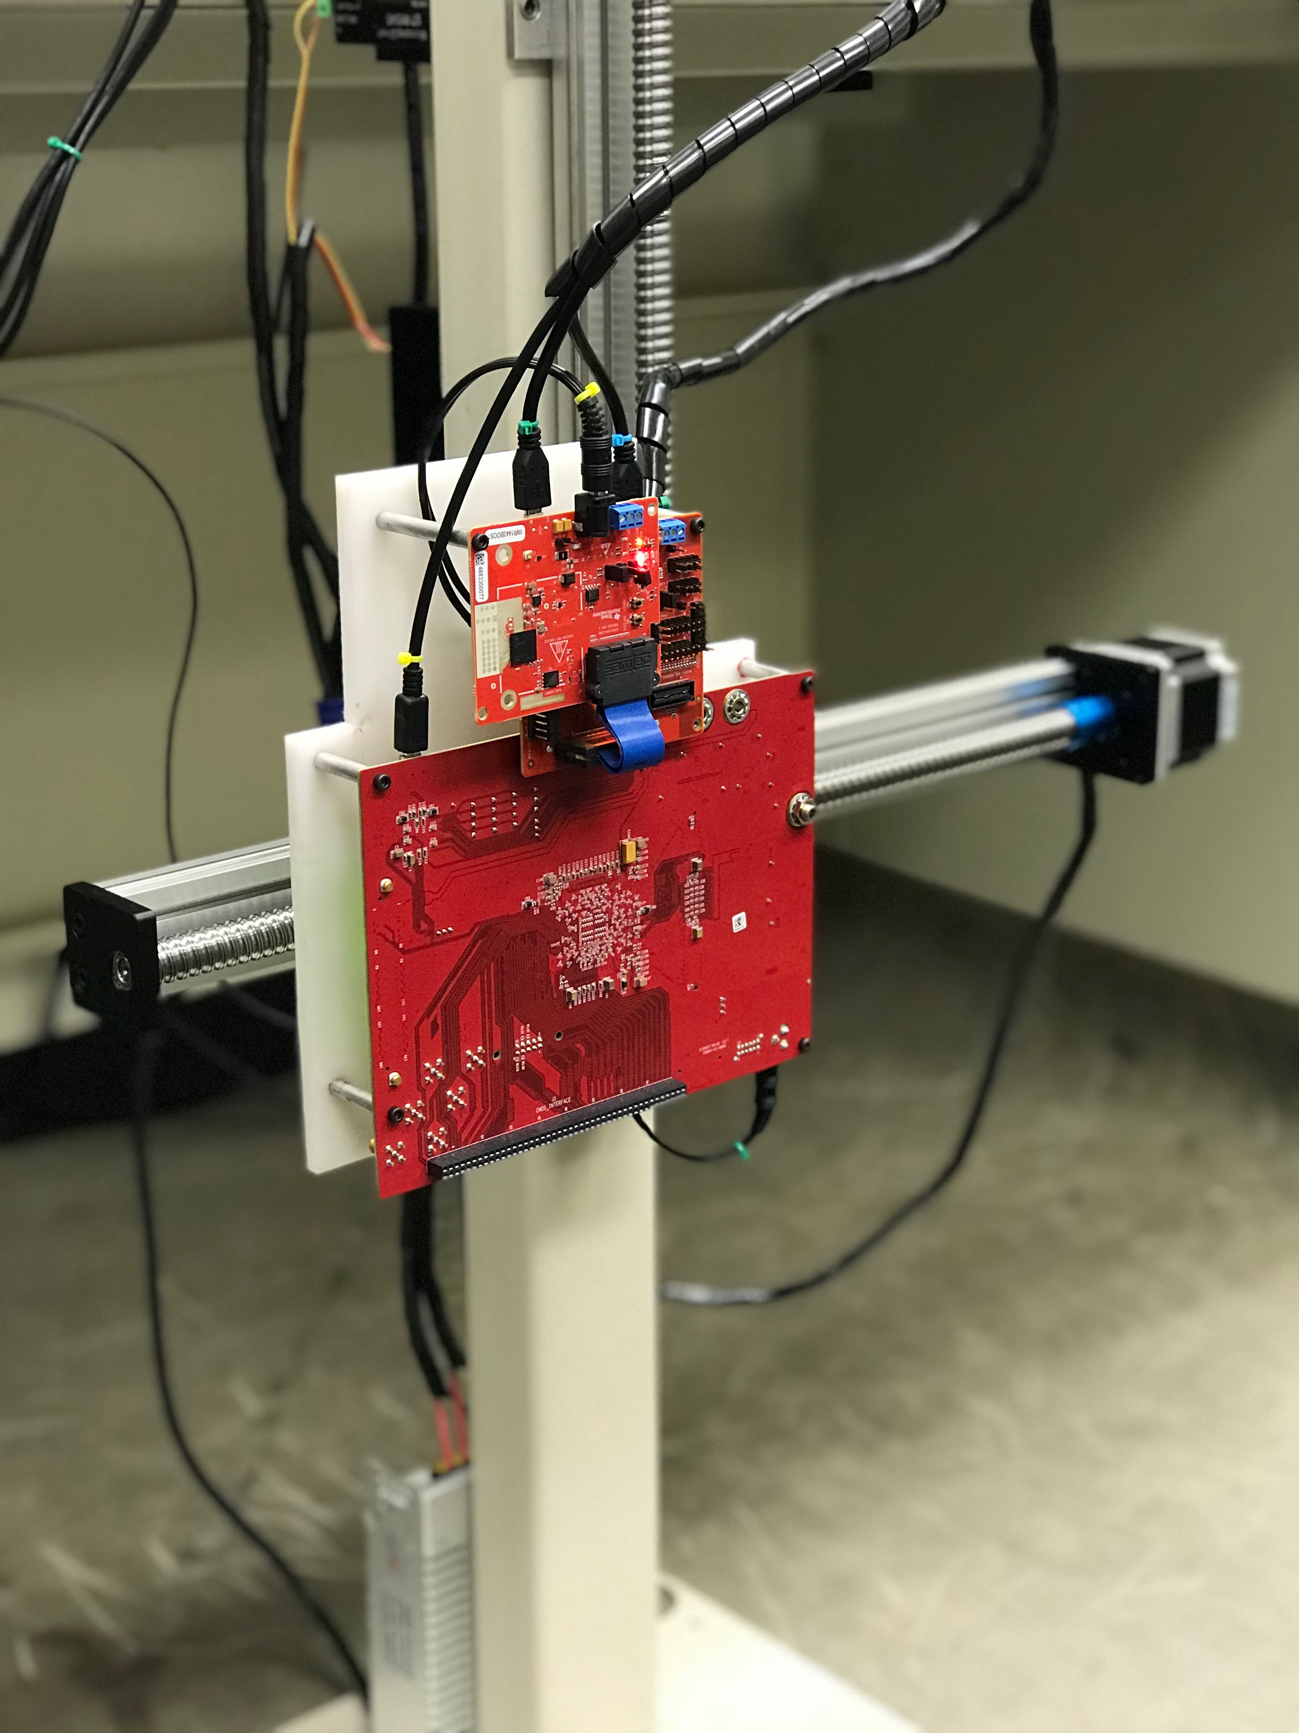
New mmwave imager TESTBED
A new version of the 2-axis mechanical scanner is built using metal parts and stand.
The maximum scanning range is 400 mm by 400 mm
Maximum speed is 20 mm/s
The mmWave sensor hardware:
77 GHz IWR1443-Boost
mmWave-Devpack+TSW1400
3

Slide 3
HIGH-LEVEL SYSTEM ARCHITECTURE
MATLAB GUI is developed to control the platform and the radar
Radar hardware is integrated into MATLAB GUI
Two-axis rail system is integrated into MATLAB GUI

Slide 4
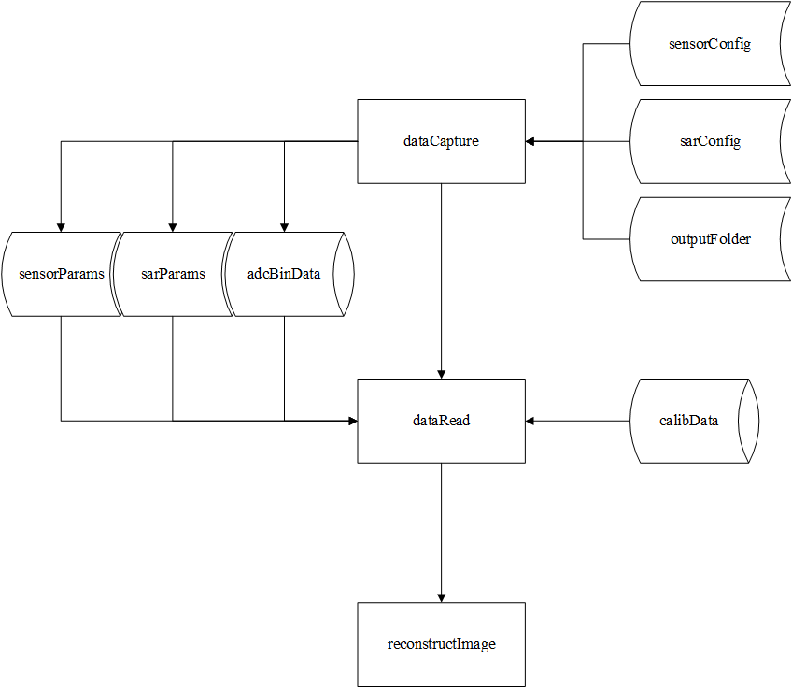
HIGH LEVEL SOFTWARE architecture
High level flow diagram of the entire MIMO-SAR image reconstruction process:
Define sensor configuration (chirp profile, number of antennas, etc.)
Define SAR configuration (number of scans, scan size, sampling, etc.)
Run SAR scenario and capture data
Store ADC data, sensor and SAR parameters
Implement one-time calibration and store the calibration data
Import ADC data to MATLAB and reshape (based on the configuration data)
Perform preprocessing (calibration, compensate near-field effects, etc.)
Reconstruct the 3-D image
4

Slide 5



SOFTWARE INSTALLATION – MATLAB AND RADAR TOOLSET
MATLAB Installation:
An 64-bit MATLAB or MATLAB runtime has to be installed.
1
Radar Studio Installation:
Radar Studio software has to be installed based on the “TI documentation”.
2
HSDC PRO Installation:
HSDC Pro software has to be installed based on the “TI documentation”.
3
5

Slide 6
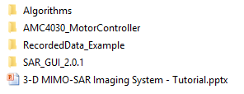
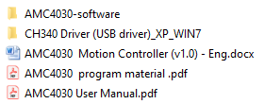
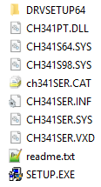
SOFTWARE INSTALLATION – AMC4030 DRIVERS
Open AMC4030-MotorController folder
Open CH340 Driver folder
Run Setup.exe to install drivers
For details, please refer to AMC4030 User Manual
1
2
3
4
6

Slide 7
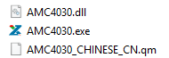
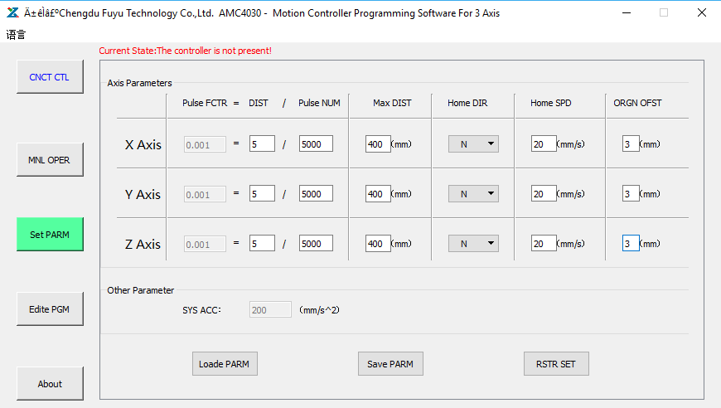
SCANNER CONFIGURATION
Open AMC4030-MotorController folder
Open AMC4030-software folder
Run AMC4030.exe
Connect to the scanner. Before, physical connection has to be established via a USB cable!
Configure the scanner parameters. Please be careful about the notes given below!
Save the parameters
2
1
3
4
Notes for the scanner hardware configuration:
DIST has to be 5 mm for the current scanner
Pulse NUM has to be compatible with HW settings (Please refer to the next page)
Max DIST has to be 400 mm for the scanner (check the HW!)
Home SPD is suggested to be set as 20 mm/s
For details, please refer to AMC4030 User Manual
5
6
7

Slide 8
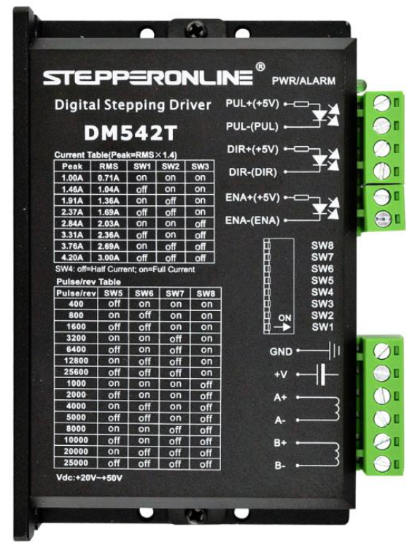
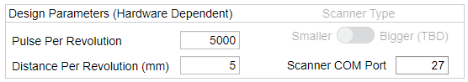
SCANNER CONFIGURATION - hardware
At each step driver, there are jumper settings to configure the number of pulses per revolution (Refer to 1)
These settings have to be consistent with the AMC4030 controller parameters (Refer to 2)
These settings in MATLAB GUI (Refer to 3) have to be consistent with the AMC4030 settings (Refer to 2)
2
1
3
8

Slide 9
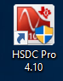
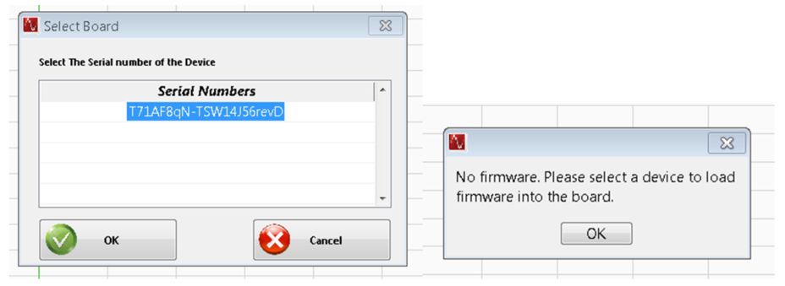
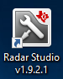

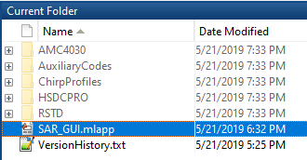
SOFTWARE USAGE
Run HSDC Pro. Connect to the board. Ignore the firmware warning.
Run Radar Studio. Wait for the entire startup script to complete. Please also wait for the firmware to be downloaded to the device.
Run MATLAB. Run SAR-GUI application. Note: Add the path of the entire folder SAR-GUI folder into MATLAB. Note: Please refer to the user guide pages of the SAR-GUI.
1
2
3
9

Slide 10
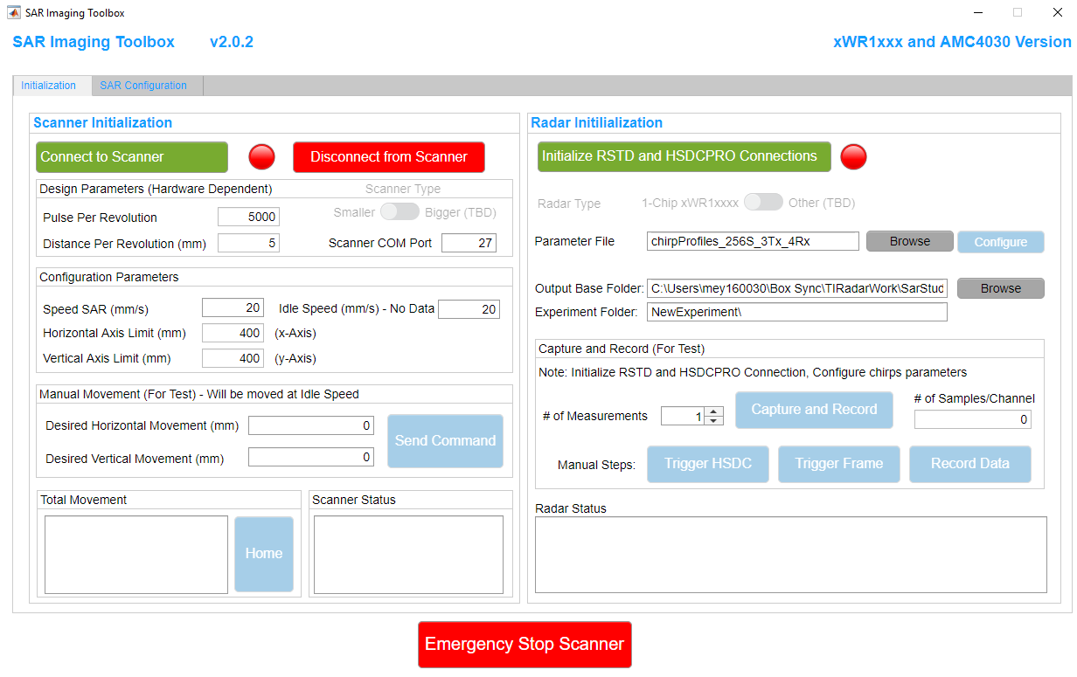
DATA CAPTURE GUI – SCANNER CONFIGURATION
Scanner Initialization page:
Connect to the scanner, LED is green when connected. Scanner will move to home position automatically.
Disconnect from the scanner, LED is red when disconnected.
Hardware dependent parameters. Has to be compatible with hardware specifications.
Speed configuration:
SAR Speed: The speed of the scanner when Radar captures data
Idle Speed: The speed of the scanner when Radar is not working
Hardware dependent axis limits.
Manual movement controls.
Emergency stop of the scanner.
1
2
3
4
5
6
7
10

Slide 11
DATA CAPTURE GUI – RADAR CONFIGURATION
Radar Initialization page:
Connect to the Radar studio and HSDC Pro. LED is green when connected.
Select the radar type (TBD).
Configure the chirp parameters.
Define the data folder for the captured data.
Manual data capture screen.
1
2
3
4
5
11

Slide 12
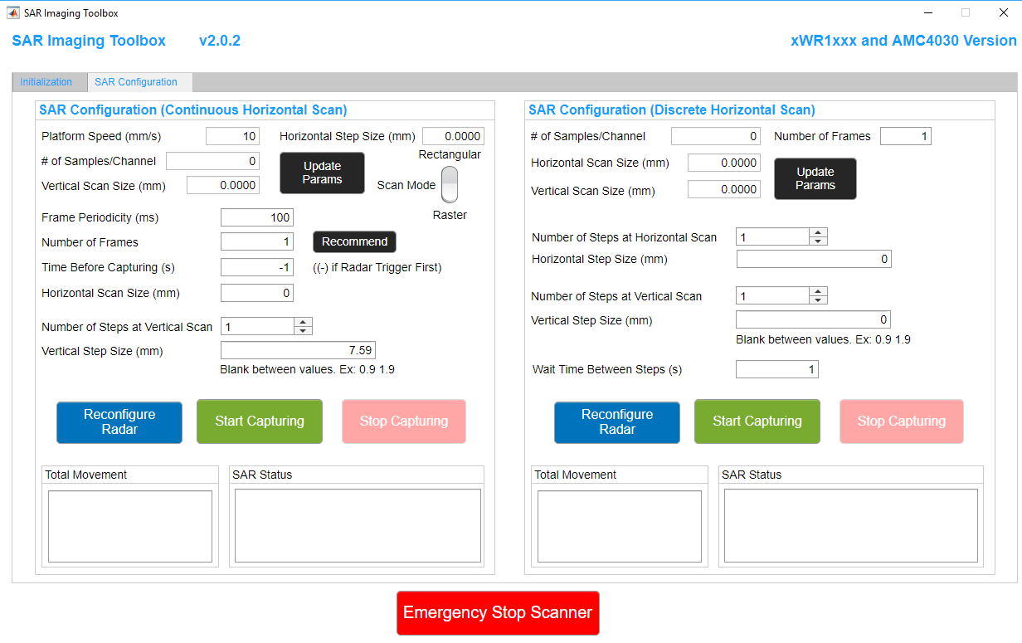
DATA CAPTURE GUI – SAR SCENARIO GENERATION
Radar Initialization page:
Define horizontal scan size.
Define the number of vertical scans and vertical step size.
Define the time offset for data capturing. (-) value means trigger starts first, and after the time offset the scanner starts moving. The data during the idle time will be cropped in data processing step.
Define frame periodicity and recommend the number of frames.
Confirm the SAR parameters.
Define the scan mode: Raster or rectangular.
Reconfigure Radar Studio and HSDC Pro. Start data capturing process.
Emergency stop button.
5
4
6
3
1
2
7
7
12

Slide 13
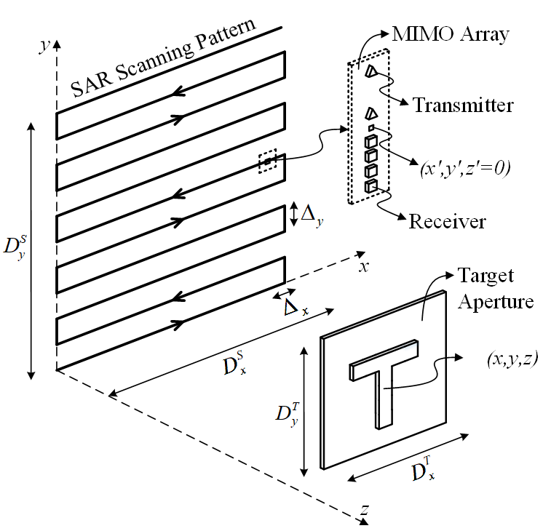
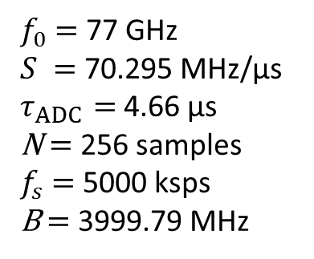
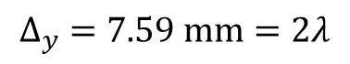
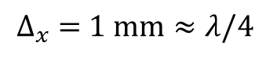
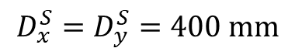
APPENDIX: MIMO-SAR SYSTEM CONFIGURATION
Data collection is performed by moving a single-chip MIMO radar along a trajectory in $x−y$ plane
MIMO array topology of IWR1443-Boost (2 TX, 4 RX )
SAR parameters:
$$D_{x}^{S}=D_{y}^{S}=400 mm$$
$$∆_{x} =1 mm≈λ/4$$
$$∆_{y} =7.59 mm=2λ$$
Same chirp parameters:
$f_{0}$ $=$ 77 GHz
$S =$ 70.295 MHz/µs
$τ_{ADC}=$ 4.66 µs
N $=$ 256 samples
$f_{s}$ $=$ 5000 ksps
B $=$ 3999.79 MHz

Slide 14
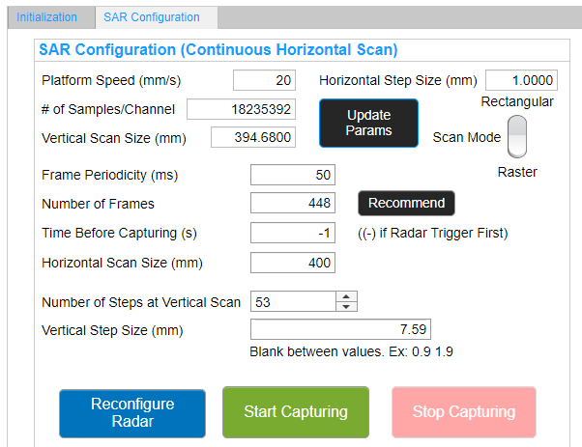
APPENDIX: AN EXAMPLE DATA CAPTURE SCENARIO
Data capture process:
Connect to the scanner.
Connect to the Radar studio and HSDC Pro.
Configure the chirp parameters.
Define the data folder for the captured data.
Configure the SAR parameters and click on Recommend button for number of frames and Update Params.
Reconfigure Radar Studio and HSDC Pro.
Start the data capturing process.
1
2
3
4
5
6
7
14

Slide 15
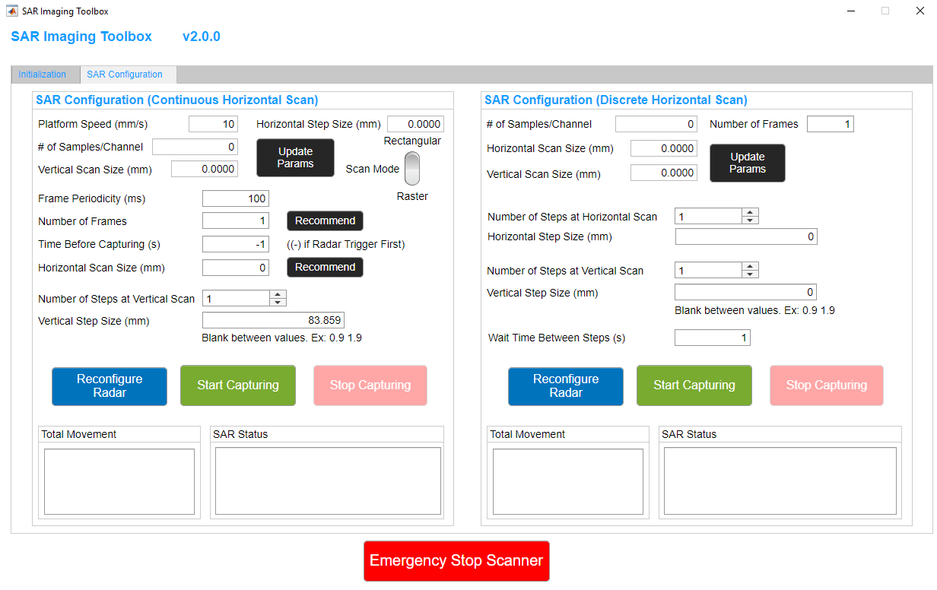
APPENDIX: SCANNER – RADAR synchronization
In this system, motion start and radar trigger commands are sent separately by MATLAB GUI
Constant speed is assumed along horizontal rail for the entire scan
Typical motion scenario (single channel)
Horizontal step size is calculated based on this architecture (dx = Frame Period x Speed).
Time offset between trigger instant and motion start.

Slide 16
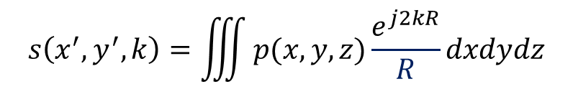
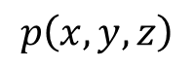
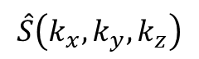
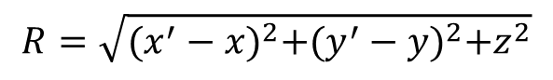
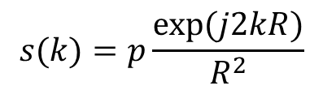
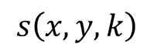
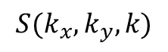
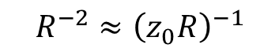
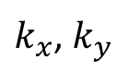
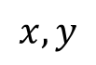
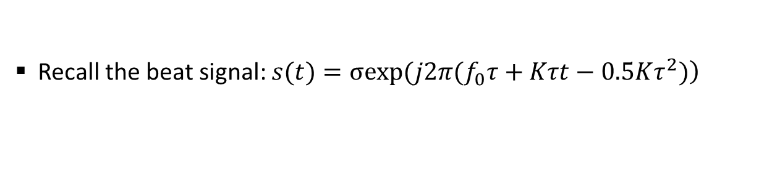
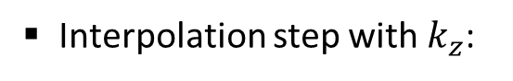
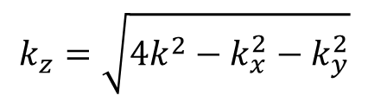
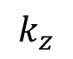
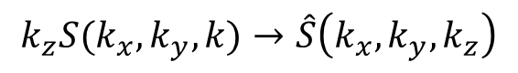
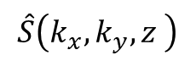
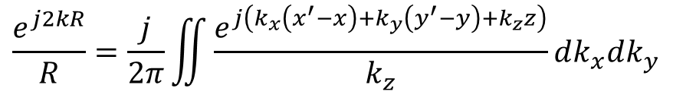
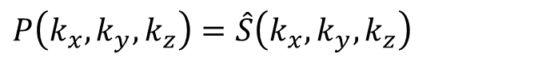
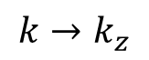
APPENDIX: 3-d MONOSTATIC Image reconstruction
Recall the beat signal: $\left.s(t)=σexp(j2π(f_{0}τ+Kτt−0.5Kτ^{2})\right)$
Residual video phase (RVP) is negligible
Rewrite in the wavenumber domain as:
$$s\left(x,y,k\right)$$
$$s(k)=p\frac{exp⁡(j2kR)}{R^{2}}$$
$$R=\sqrt{{(x^{′}−x)}^{2}+{(y^{′}−y)}^{2}+z^{2}}$$
$$x,y$$
FFT2
$$S(k_{x},k_{y},k)$$
The received monostatic backscattered data from a 3-D target
$$s\left(x^{′},y^{′},k\right)=\iiint{p(x,y,z)\frac{e^{j2kR}}{R}dxdydz}$$
Interpolate
$$\hat{S}\left(k_{x},k_{y},k_{z}\right)$$
$$R^{−2}≈{\left(z_{0}R\right)}^{−1}$$
$$k→k_{z}$$
Representation of a spherical wave as a superposition of plane waves
$$k_{z}$$
FFT
$$\hat{S}\left(k_{x},k_{y},z \right)$$
$$\frac{e^{j2kR}}{R}=\frac{j}{2π}\iint{\frac{e^{j\left(k_{x}\left(x^{′}−x\right)+k_{y}\left(y^{′}−y\right)+k_{z}z\right)}}{k_{z}}dk_{x}dk_{y}}$$
$$k_{z}=\sqrt{4k^{2}−k_{x}^{2}−k_{y}^{2}}$$
$k_{x}$, $k_{y}$
IFFT2
The final 3-D image in spectral domain:
$$P\left(k_{x},k_{y},k_{z}\right)=\hat{S}\left(k_{x},k_{y},k_{z}\right)$$
$$p\left(x,y,z\right)$$
Interpolation step with $k_{z}$:
$$k_{z}S(k_{x},k_{y},k)→\hat{S}\left(k_{x},k_{y},k_{z}\right)$$
3-D image formation
16

Slide 17
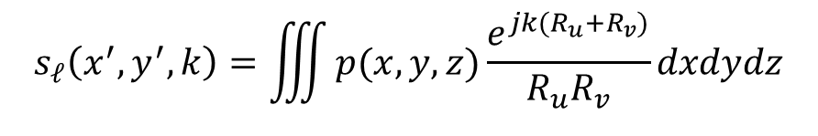
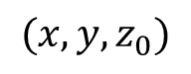
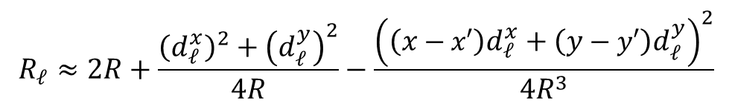
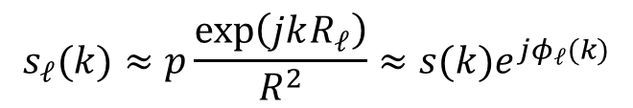
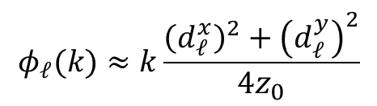
APPENDIX: MULTISTATIC EFFECT IN NEAR-FIELD
Midpoint approximation: $\left|r_{u}−r_{v}\right|≤\sqrt{4αλR}$ for a small $α$ doesn’t hold in near field
The total round-trip distance for the $ℓ$-th virtual channel
$$R_{ℓ}=R_{u}+R_{v}=\sqrt{{(x_{u}−x)}^{2}+{(y_{u}−y)}^{2}+z_{0}^{2}}+\sqrt{{(x_{v}−x)}^{2}+{(y_{v}−y)}^{2}+z_{0}^{2}}$$
$$s_{ℓ}\left(x^{′},y^{′},k\right)=\iiint{p(x,y,z)\frac{e^{jk(R_{u}+R_{v})}}{R_{u}R_{v}}dxdydz}$$
Complex solution:
Taylor expansion
$$R_{ℓ}≈2R+\frac{{\left(d_{ℓ}^{x}\right)}^{2}+{\left(d_{ℓ}^{y}\right)}^{2}}{4R}−\frac{{\left(\left(x−x′\right)d_{ℓ}^{x}+\left(y−y′\right)d_{ℓ}^{y}\right)}^{2}}{4R^{3}}$$
Multistatic to monostatic phase correction is proposed
$$(x,y,z_{0})$$
The received signal by the $ℓth$ hypothetical monostatic element:
$$s_{ℓ}(k)≈p\frac{\exp\left(jkR_{ℓ}\right)}{R^{2}}≈s(k)e^{jφ_{ℓ}(k)}$$
$$φ_{ℓ}(k)≈k\frac{{\left(d_{ℓ}^{x}\right)}^{2}+{\left(d_{ℓ}^{y}\right)}^{2}}{4z_{0}}$$
17

